Slide 1
Introduction to Unsupervised Machine Learning
Lesson 18.1

Slide 2
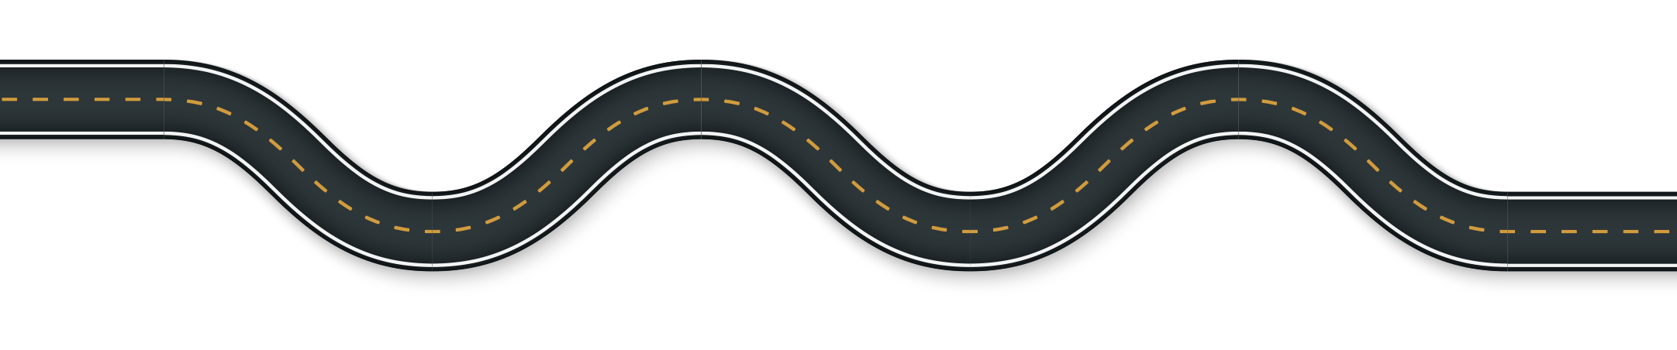
The Big Picture
Python Unit
Python
Pandas
Matplotlib
APIs
Unit Assessment
Final Project
Project Design
Train Model & Build Database
Dashboards Presentation
Python Unit
Python
Pandas
Matplotlib
APIs
Unit Assessment
Visualization Unit
Web Scraping
Plotly
Leaflet
Tableau
Unit Assessment
Visualization Unit
Web Scraping
Plotly
Leaflet
Tableau
Unit Assessment
01
03
03
05
05
02
06
02
04
04
Excel Unit
Excel
VBA
Unit Assessment
Databases Unit
SQL
ETL
SQLite
Unit Assessment
Databases Unit
SQL
ETL
SQLite
Unit Assessment
Advanced Topics Unit
R—Stats
Big Data—AWS
Machine Learning
Unit Assessment
Advanced Topics Unit
R—Stats
Big Data—AWS
Machine Learning
Unit Assessment
Notes:
Data

Slide 3

Quick Tip for Success:
Take some time and review any past-due assignments you may be missing! The end of the course is coming up soon.

Slide 4
This Week:
Unsupervised Machine Learning
Module 18

Slide 5
This Week: Unsupervised Machine Learning
By the end of this week, you’ll know how to:
Describe the differences between supervised and unsupervised learning, including real-world examples of each
Preprocess data for unsupervised learning
Cluster data using the K-means algorithm
Determine the best amount of centroids for K-means using the elbow curve
Use principal component analysis (PCA) to limit features and speed up the model

Slide 6

This Week’s Challenge
Using the skills learned throughout the week, you will analyze cryptocurrency data, reduce data dimensions with principal component analysis, cluster with K-means, and visualize the results.

Slide 7

Career Connection
How will you use this module’s content in your career?

Slide 8
How to Succeed This Week
Module 18

Slide 9
Quick Tip for Success:
Today, we’re continuing to build an understanding of the basics of machine learning. There are still many skills to learn!

Slide 10
Today’s Agenda
Module 18

Slide 11
Today’s Agenda
By completing today’s activities, you’ll learn the following skills:
01
Preparing and processing data for unsupervised learning
02
Applying K-means clustering
03
Using the elbow curve to determine optimal cluster number
Make sure you’ve downloaded any relevant class files!

Slide 12
How comfortable do you feel with this topic?

Slide 13
Intro to Unsupervised Machine Learning
Notes:
2.1 Instructor Do: Introduction to Unsupervised Learning (0:10)

Slide 14

Unsupervised Learning vs. Supervised Learning Unsupervised Learning
Unsupervised Learning
Supervised Learning
Continuous target variable
Categorical target variable
Target variable not available
vs.
Clustering
Association
Regression
Classification
Customer segmentation
Market basket analysis
Housing price prediction
Medical Imaging

Slide 15
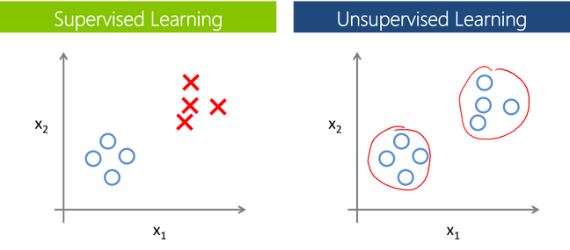
Supervised vs. Unsupervised Learning
Supervised Learning
Unsupervised Learning
vs.
Input data is labeled.
Uses training datasets.
Goal: Predict a class or value.
Input data is unlabeled.
Uses just input datasets.
Goal: Determine patterns or grouping data.

Slide 16
Supervised vs. Unsupervised Learning
Supervised Learning
Unsupervised Learning
vs.
Input data is labeled.
Uses training datasets.
Goal: Predict a class or value.
Input data is unlabeled.
Uses just input datasets.
Goal: Determine patterns or grouping data.

Slide 17


Supervised vs. Unsupervised Learning
Supervised Learning
Upbeat Millennial
purchases Matcha tea drinks most often
Behaviors
Average purchase per month: $64.32
Motivations
The most important factor in decision to purchase is knowing that the tea is sustainably sourced.
Is this person satisfied?
How much is this customer going to spend next month?

Slide 18

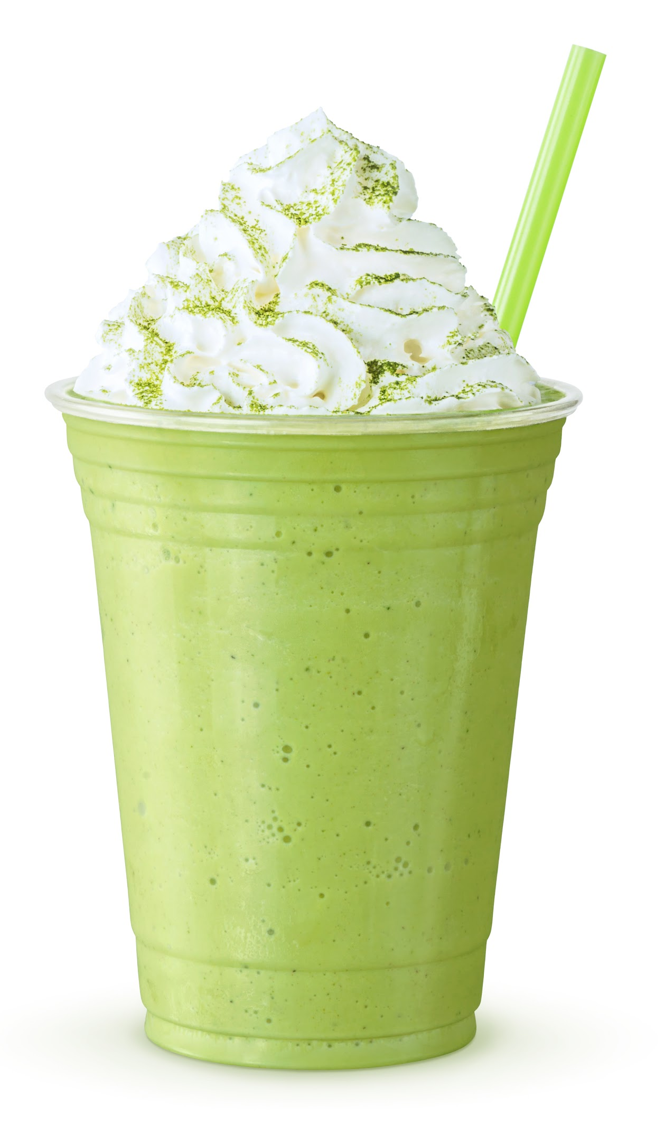
Supervised vs. Unsupervised Learning
Unsupervised Learning
How can I create an offer customized to customers?
 | Buy one Green Tea Smoothie, get one free A great deal WITH great health benefits. Green tea is known for the remarkable and essential health benefits that a daily cup can bring.
Buy Now

Slide 19

Unsupervised Learning
Common uses of unsupervised learning:
Grouping unlabeled data into distinct clusters (clustering).
Detecting unusual data points in a dataset—i.e., anomaly detection.
Reducing large datasets into smaller datasets while preserving most of the useful information (dimensionality reduction).

Slide 20
How is clustering used by retail businesses?

Slide 21

Clustering
Clustering can be used to group customers by shopping habits to create customized offers via email or mobile apps.
‹#›

Slide 22
How is anomaly detection used by credit card companies?

Slide 23

Anomaly Detection
Anomaly detection can be used to identify anomalous and potentially fraudulent credit card transactions (by grouping transactions into normal vs. abnormal).

Slide 24
How is dimensionality reduction used in organizations?

Slide 25
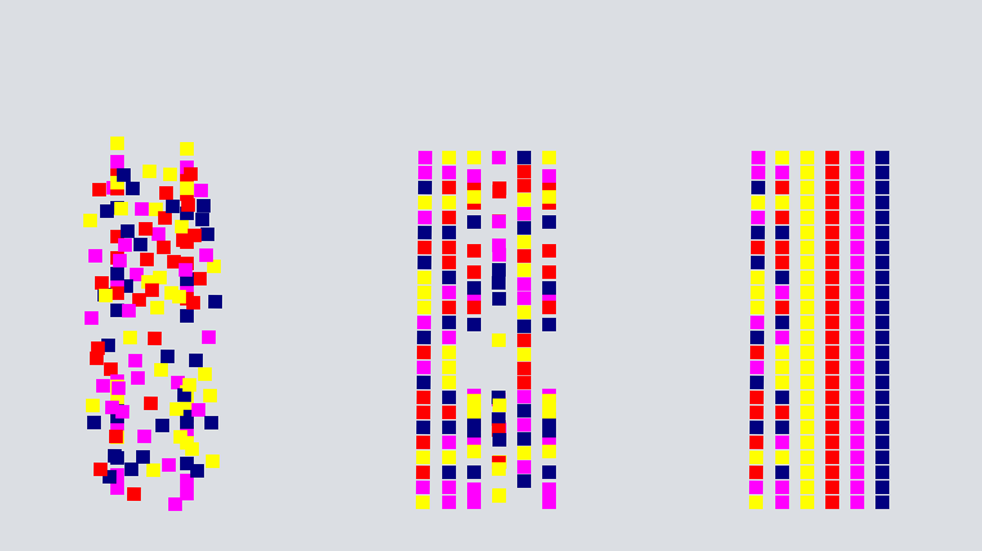
Dimensionality Reduction
It can speed up machine learning by reducing the size of large datasets.
‹#›

Slide 26
Supervised Learning
Supervised learning is very helpful at predicting the future based on labeled historical data. However, labeled data is not always available.
Population
Positive
Negative
Predictive Model
Predictive Positive
Predictive Negative

Slide 27
Unsupervised learning allows us to cluster data to find hidden or unknown patterns in data.

Slide 28
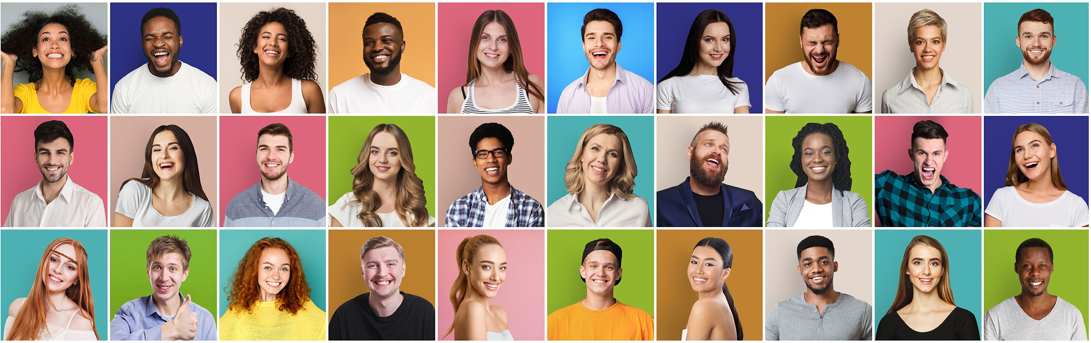
Customer Segmentation
Customer segmentation is one of the most popular applications of unsupervised learning. It categorizes customers based on their demographic and behavioral traits.

Slide 29
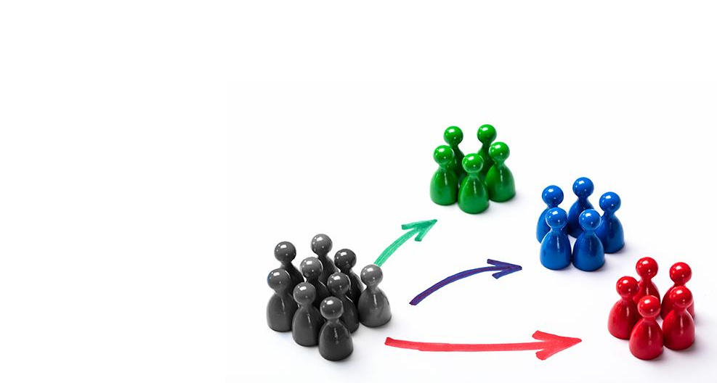
Customer Segmentation
With unsupervised learning algorithms, we can group customer-based similarities such as:
Customer needs (e.g., a particular product can satisfy some of them)
Responses to online marketing channels
Buying habits (e.g., best day for buying, weekly spend, etc.)
‹#›

Slide 30
Customer segmentation is a major revenue driver for leading companies like Netflix and Amazon.

Slide 31
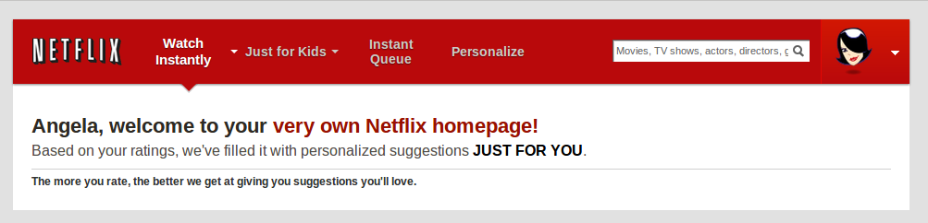
Customer Segmentation
75% of Netflix viewer activity is driven by recommendation.
Netflix’s recommendation system saves the company an estimated $1 billion per year through reduced churn.
wired.com
30

Slide 32
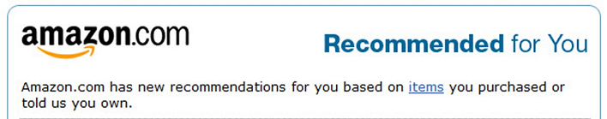
Customer Segmentation
35% of Amazon’s sales are generated through their recommendation engine.
martechadvisor.com

Slide 33
Data Preparation
Notes:
3. Data Preparation

Slide 34
Data Preparation
Data selection
Data preprocessing
Data transformation
Make a good choice of what data is going to be used. It is important to consider what is available in the dataset, what is missing, and what can be removed.
Organize the selected data by formatting, cleaning, and sampling it.
Transform the data to a format that eases its treatment and storage for future use (e.g., CSV file, spreadsheet, database).

Slide 35
Data Preparation for Unsupervised Learning
Notes:
* Next, open Data_Preparation.ipynb and introduce sklearn's built-in iris dataset. Explain that this dataset has already been cleaned up and is ready to use.

Slide 37
Activity: Understanding Customers
In this activity, you will perform data preparation tasks on a dataset about the purchases made by 200 customers on an e-commerce website.
20 minutes
Notes:
3.2 Students Do: Understanding Customers (0:20)

Slide 38
Activity: Understanding Customers
Annual Income | This feature should be regularized since it is on a different scale than the other features; dividing by 1000 is the simplest solution.
Previous Shopper | The Previous Shopper should be transformed to a numerical value; in this case, transforming Yes to 1 and No to 0 is a feasible solution.
CustomerID | Since this column is not relevant to the clustering algorithm, it should be dropped from the DataFrame.

Slide 39
Notes:
3.3 Review Activity (0:10)

Slide 41
Boston Marathon Preprocessing
20 minutes
Notes:
3.4 Everyone Do: Boston Marathon Preprocessing

Slide 42
K-Means Algorithm
Notes:
4. K-Means Algorithm

Slide 43
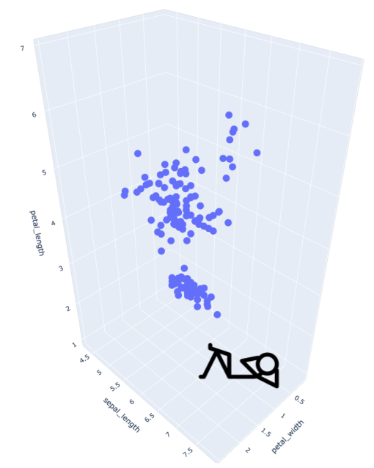
What Can K-Means Do for Me?
Imagine that you are in a room full of small spheres (data points).
Each sphere represents a flower (iris), and the axes represent features of flowers.
‹#›

Slide 44
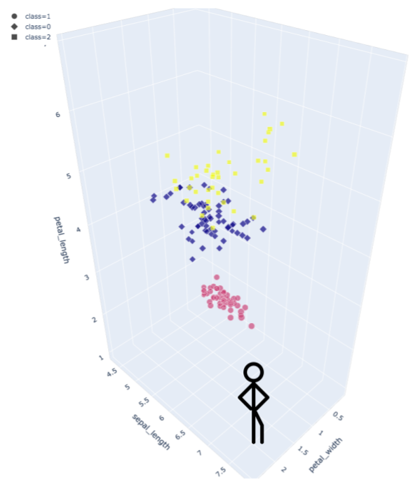
What Can K-Means Do for Me?
K-means is an unsupervised learning algorithm used to identify clusters.
‹#›

Slide 45
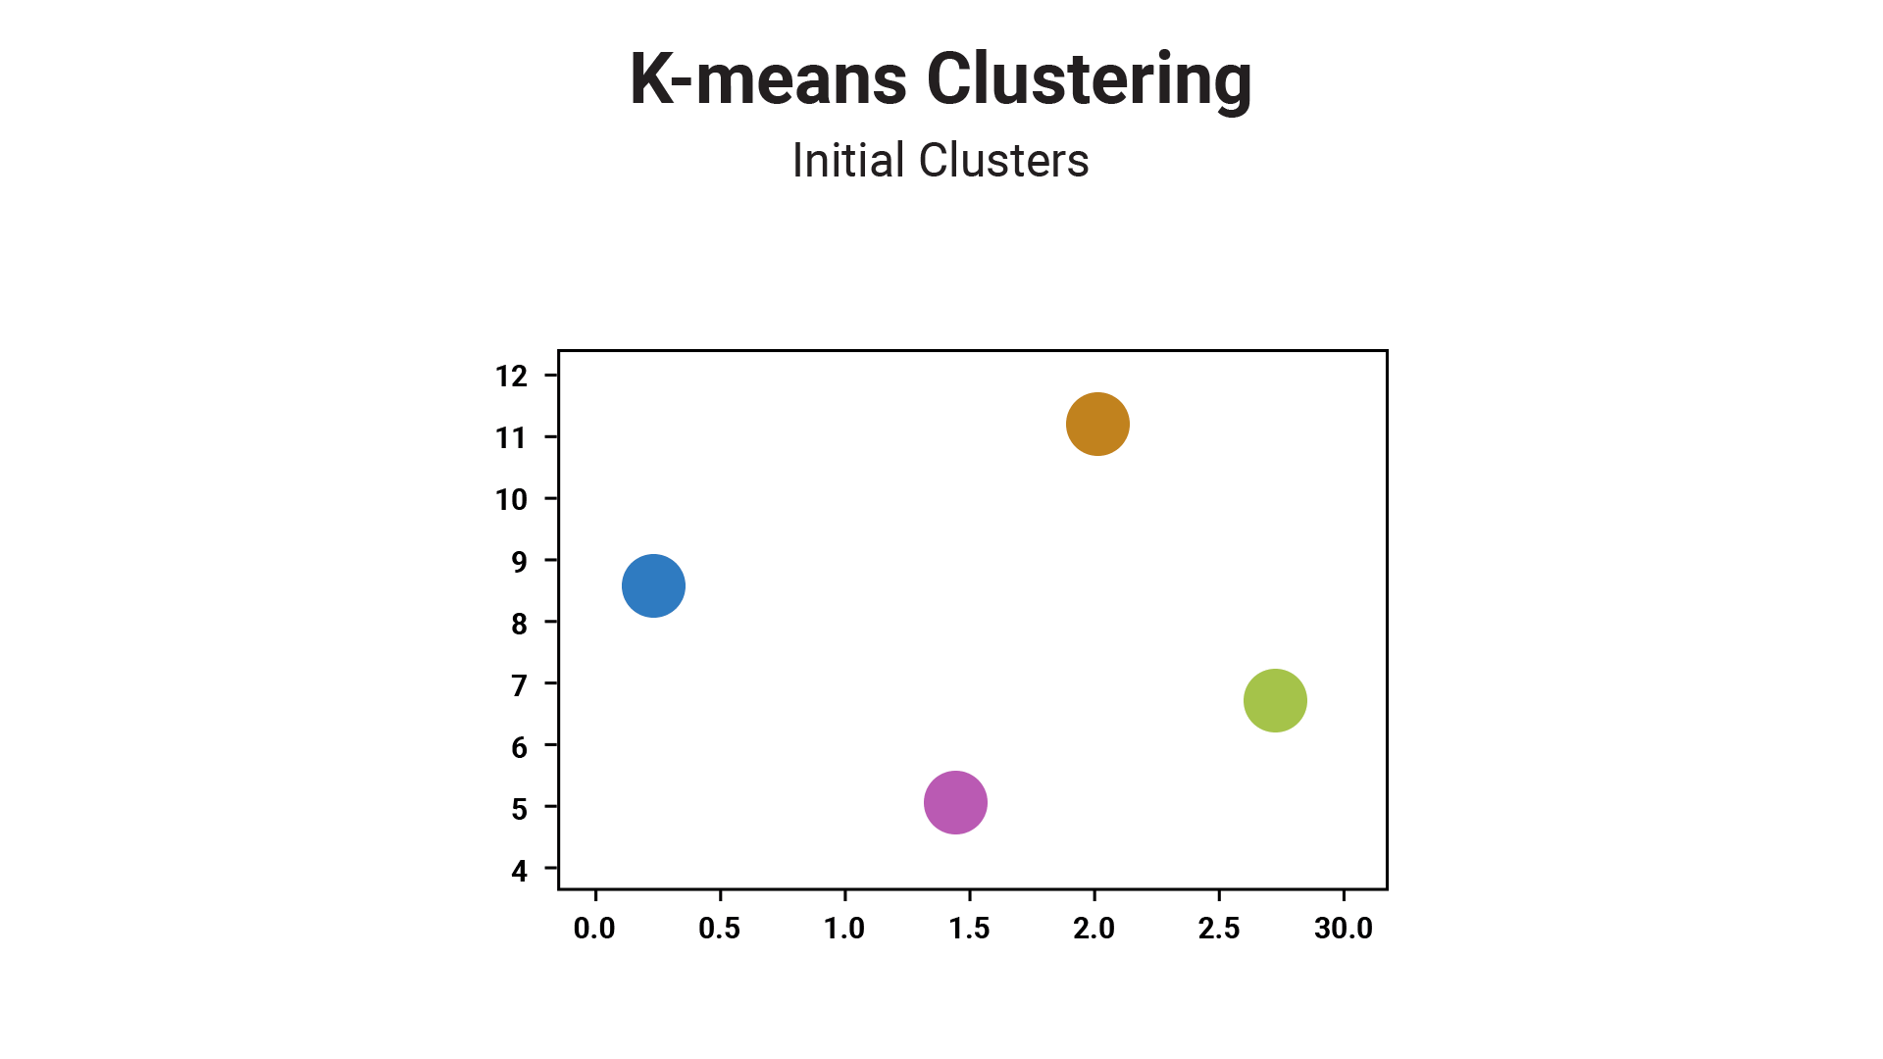
How the K-Means Algorithm Works

Slide 46
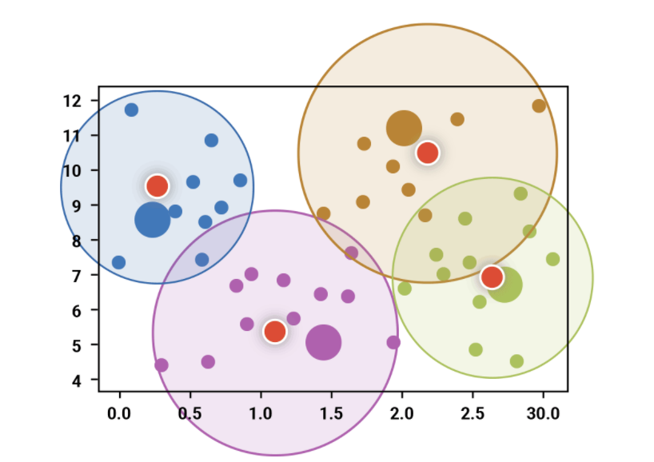
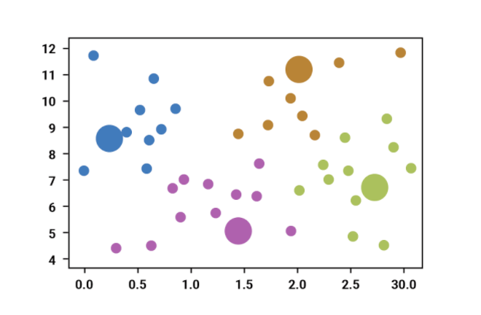
How the K-Means Algorithm Works
k clusters
Centroid
The K-means algorithm groups the data into k clusters, where belonging to a cluster is based on some similarity or distance measure to a centroid.
A centroid represents a data point in the arithmetic mean position of all the points on a cluster.

Slide 47

How the K-Means Algorithm Works
Algorithm at a glance:
01
Randomly initialize the k starting centroids.
02
Each data point is assigned to its nearest centroid.
03
The centroids are recomputed as the mean of the data points assigned to the respective cluster.
04
Repeat steps 1 through 3 until the stopping criteria is triggered.

Slide 48
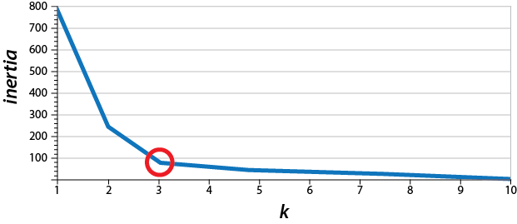
What Is the Best Number for k?
This is done using an elbow curve where the x-axis is the k value and the y-axis is some objective function.
A common objective function is the inertia.
Elbow Curve

Slide 49
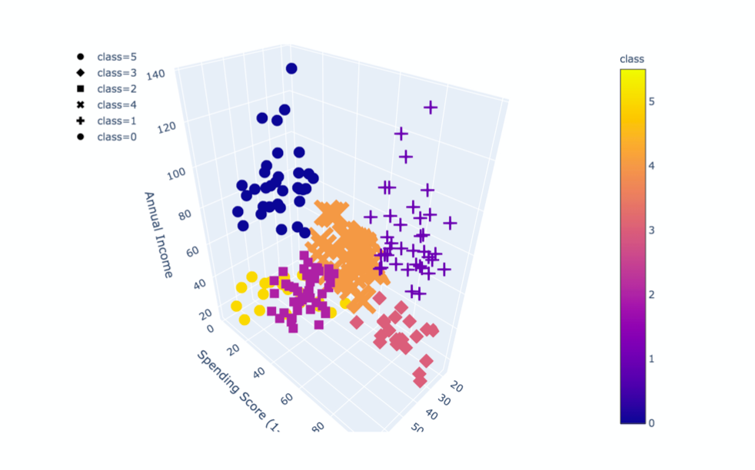
K-Means with 3 Features

Slide 50
Chicago Marathon K-Means
Notes:
* Next, open [ChicagoMarathonKMeans.ipynb]

Slide 52
Activity: K-Means
In this activity, you will will apply the K-means algorithm on a different marathon dataset.
20 minutes
Notes:
4.2 Students Do: K-means (0:20)

Slide 53
Notes:
4.3 Review: K-means (10 min)

